Slide 1

Unit 2 Group Presentation
By Alisha Aslam, Arjun Bhatnagar and Peter Captain

Slide 2
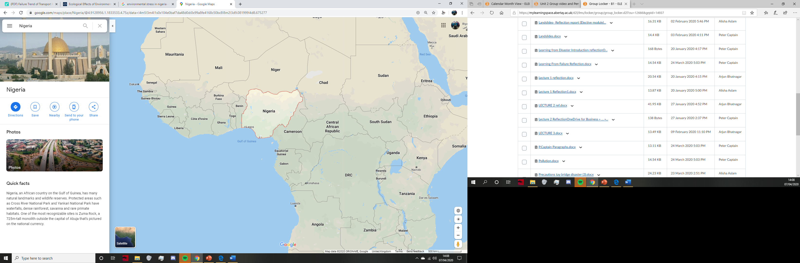

Nigeria
Nigeria is a developing country located in central Africa, on the Gulf of Guinea.
Nigeria suffers from many natural and manmade environmental stresses, the biggest ones being urbanization, deforestation, desertification and pollution.
As the country has rapidly developed, so too has the infrastructure around the country expanded and the need for new structures such as bridges .

Slide 3
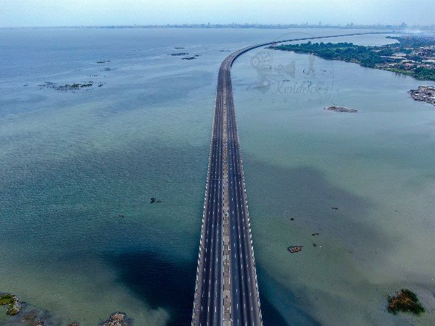

Intro to the 3rd Mainland Bridge
At the time, was known as the longest bridge in Nigeria
Built because of the population growth (increase in traffic)
Approx. 11.8 km
Opened in 1990
Connected from the Lagos Island to the Mainland

Slide 4

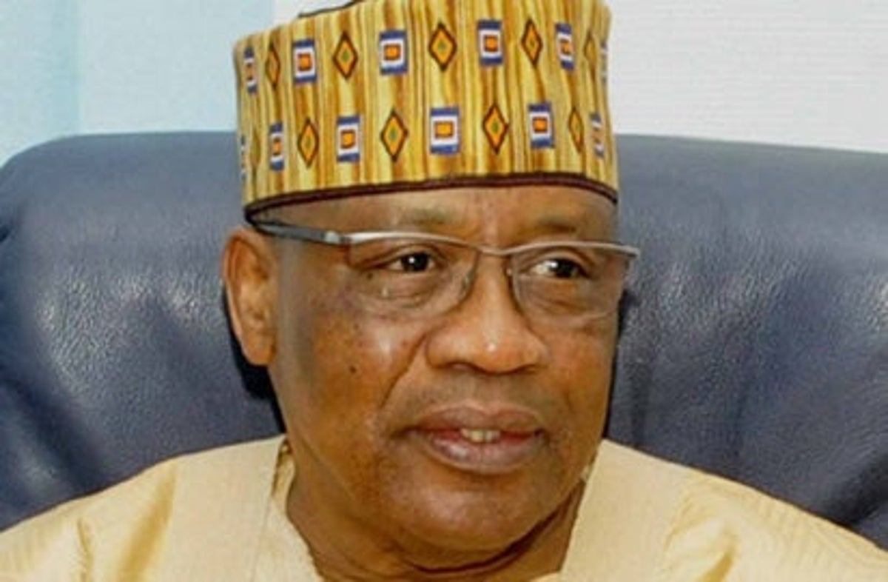

Continued
8 Lane bridge
Constructed by Julius Berger
It Was known that General Ibrahim Babangida
(Nigerian Head of State) was quite determined
to have this project once again in the works

Slide 5
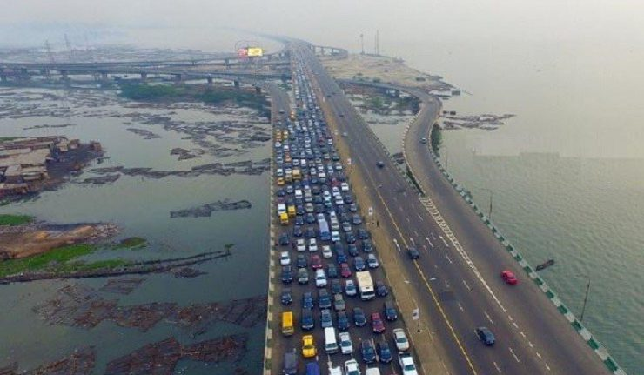
Mitigating consequences
Had to be closed due to a “investigative maintenance test”
As a result of the bridge closing for a short period of time,
the traffic had to be diverted to alternative routes
Even though the bridge re-opened earlier than expected,
this was authorised by the engineers

Slide 6
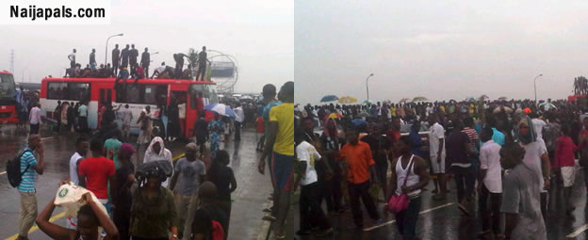
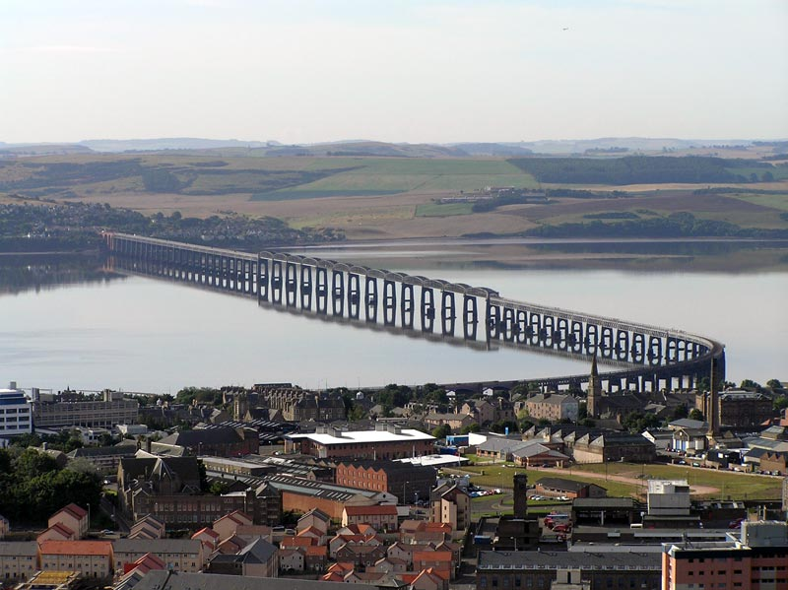
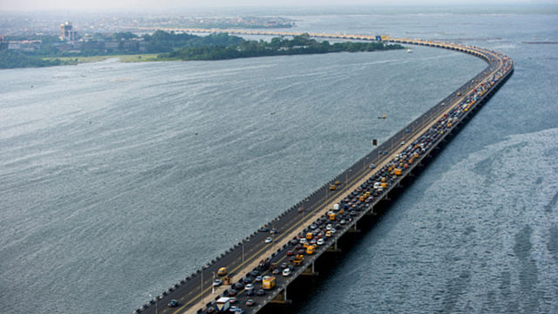
Lessons to be taken
Checked for work or renovations needed
Some commuters addressed their concerns in 2006,
with them being addressed- unlike
with the Tay bridge disaster
People were not afraid to speak up about concerning issues

Slide 7
However…
There was a panic among the people when there was talk and a text message saying that it was not safe to use the bridge
This was addressed by the general and backed up by the government that the rumours were false

Slide 8
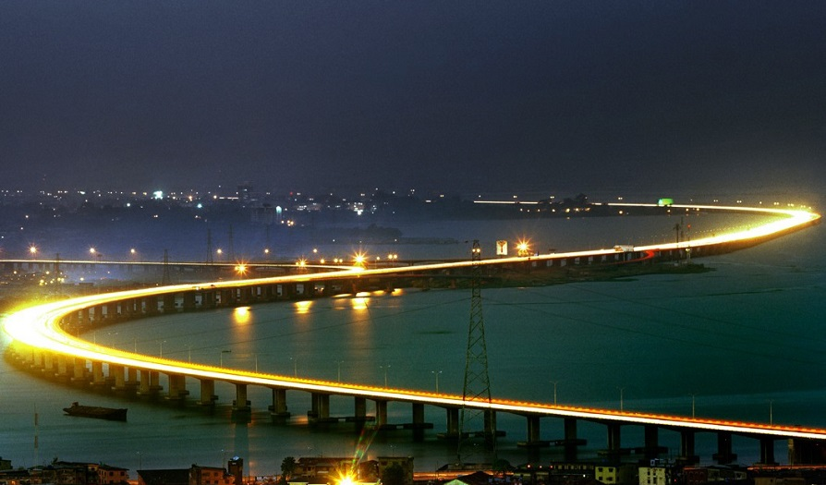
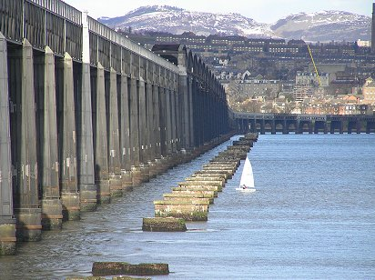
Similarities to Tay Bridge
Didn’t keep the bridge in good condition (as much as they could)
Communication was not effective (as it could have been)

Slide 9
Conclusion
3rd Mainland Bridge was essentially built because of the ongoing population growth
It was very important for a structure that is used constantly to be secure
It was an incident that caused a lot of the public to be concerned and panic
Overall, unlike with the Tay Bride- people spoke up on what they thought be fixed regarding the bridge
Many renovations and checks were made over the years

Slide 10
Sources
Google Maps Image of Nigeria https://www.google.com/maps/place/Nigeria/@2.3736905,-5.1214075,4.5z/data=!4m5!3m4!1s0x104e0baf7da48d0d:0x99a8fe4168c50bc8!8m2!3d9.081999!4d8.675277
3rd Mainland Bridgehttps://www.bing.com/images/search?view=detailV2&ccid=JjgSZixD&id=9C189D9DBEE456AE6EB5011164E9755F595099FE&thid=OIP.JjgSZixDJK4jspikhDL2fQHaFj&mediaurl=https%3a%2f%2fautojosh.com%2fwp-content%2fuploads%2f2019%2f03%2fIMG_20190310_085414_793-600x450.jpg&exph=450&expw=600&q=3rd+mainland+bridge&simid=608046362344032698&selectedIndex=92&ajaxhist=0

